Slide 1
Tolerances and Tolerancing Techniques
John R. Rogers, Ph.D.
Senior Scientist, Imaging Engineering
Synopsys, Inc.
October 31, 2019

Slide 2
The Tolerance Process
Assign:
Tolerances
and
Compensators
Simulate
As-Built Performance
(TOR or TOLMONTE)
Tighten
Something
Or
Add Compensators
Good Enough?
No
Yes
Done!

Slide 3
The Tolerance Process
Assign:
Tolerances
and
Compensators
The goal here is to simulate exactly what will happen in the fabrication process
Simulate
As-Built Performance
(TOR or TOLMONTE)
Tighten
Something
Or
Add Compensators
Good Enough?
No
Yes
Done!

Slide 4
Initial Tolerance Assignment (My approach; others have their own approaches)
Assign “easy” tolerances
When it doesn’t work, tighten the ones that cause the most damage to “moderately difficult” levels
TOR gives good feedback for this
Keep tightening until the performance is OK
Hopefully you don’t have to move any tolerances to “borderline impossible” levels!
At some point you may need to have a discussion with someone about using alignment compensators. Which do they prefer:
Tight tolerances and no compensators?
Looser tolerances, but a more complex assembly involving alignment compensators?

Slide 5
Example Lens

Slide 6
Layout
EFL = 37.8 mm
F/2.5
Semi field = 30º (to corner)
Format: 24 x 36 mm
2913 x 3155 pixels
Pixel pitch = 0.00824
(Nyquist = 60.7 cy/mm)

Slide 7
Transverse Aberrations

Slide 8
RMS Spot Diameters
Pixel pitch = 0.00824
Spot sizes are sub-pixel

Slide 9
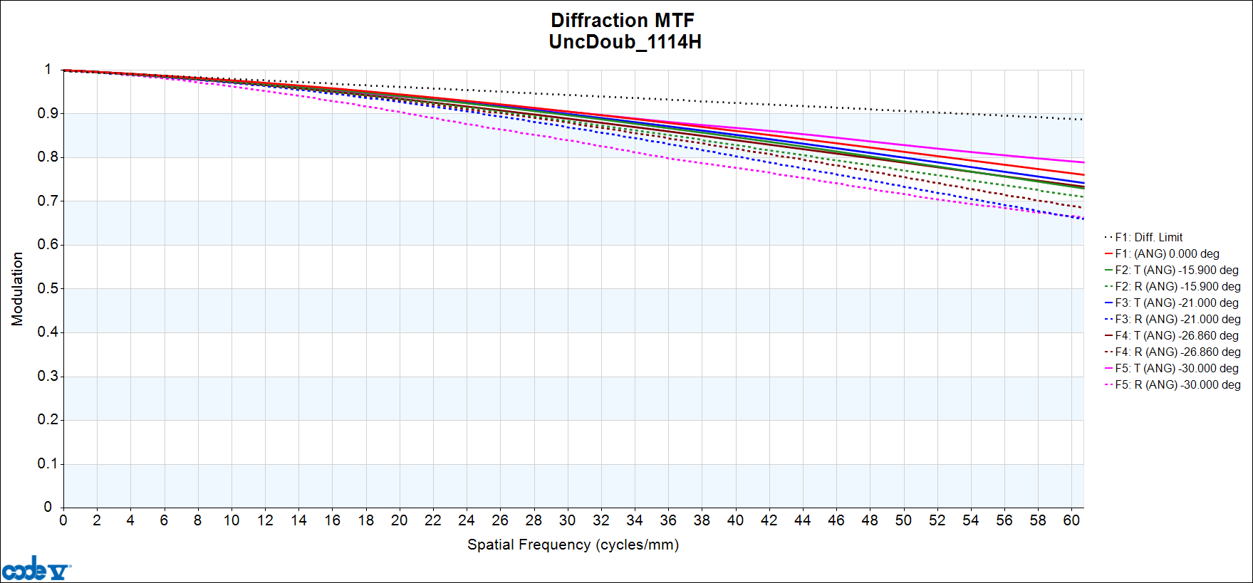
MTF

Slide 10
Notional Housing Scheme
Lenses mounted against seats
Elements 1 – 3 loaded from the front
Remaining elements loaded from the rear
Decenters controlled by the element ODs
The housing is in two halves

Slide 11
Field Locations For Tolerancing

Slide 12
One Logical Sampling of the Field
This pattern is equivalent to sampling at the following locations:
Center
Top/Bottom Edges
Right/Left Edges
Corners
(It is convenient to be able to discuss the as-built performance at these locations.)

Slide 13
One Logical Sampling of the Field
This pattern is equivalent to sampling at the following locations:
Center
Top/Bottom Edges
Right/Left Edges
Corners
(It is convenient to be able to discuss the as-built performance at these locations.)
The sampling is fully symmetric in the field.
This is important (at least with a Monte Carlo), particularly when transverse compensators are considered.
(Don’t just sample a single spoke in the field!)

Slide 14
One Logical Sampling of the Field
One drawback:
Because the field locations are on the diagonals, then the 0º and 90º (X and Y) orientations are not the same as “Radial” and “Tangential”

Slide 15
One Logical Sampling of the Field
One drawback:
Because the field locations are on the diagonals, then the 0º and 90º (X and Y) orientations are not the same as “Radial” and “Tangential”
Solution:
Rotate the four spokes into the vertical and horizontal directions…

Slide 16
Field Sampling for Tolerancing
Same pattern, just rotated.

Slide 17
Field Sampling for Tolerancing
4
The 0º MTF is radial at field points 4 and 10, and tangential at field points 7 and 13.
Similarly, the 90º MTF is tangential at field points 7 and 13, and radial at field points 4 and 10.
3
2
Relative Radial Positions For Aspect Ratio 36:24
Point # | Relative Radial Position
1 | 0.000
2, 5, 8, 11 | 0.555
3, 6, 9, 12 | 0.832
4, 7, 10, 13 | 1.000
13
12
11
1
5
6
7
8
9
10

Slide 18
Tolerances
(With rules of thumb for tolerance levels)

Slide 19
Caveat
This section (and the file settols.seq) contain some rules of thumb, but they are only rules of thumb
Appropriate tolerance levels – and even tolerance types – depend on:
How the elements are to be fabricated
How the elements are to be tested
How the elements are to be mounted
How (and the extent to which) the elements are to be aligned
Communication is the key to success
The rules of thumb provided here are based on personal experience
Other sources include websites of fabricators:
https://www.edmundoptics.com/capabilities/spherical-manufacturing/
https://www.optimaxsi.com/innovation/optical-manufacturing-tolerance-chart/
Further tolerance considerations are given in the appendix to this presentation

Slide 20
Radius of Curvature Errors
Classical approach: specify two tolerances
The number of fringes of “power” between the surface and its test plate
The error (uncertainty) in the knowledge of the radius of the test plate
Many shops no longer use test plates, but measure the radius of curvature of each part on a bench
For this reason, two specifications are no longer necessary
However, long-radius parts are harder to measure
Manufacturers typically use statements like “The greater of 0.3% or 3 fringes”
This means the optical engineer needs to convert a hypothetical 0.3% radius error into fringes, and decide whether it is larger or smaller than 3 fringes.
(Don’t make this comparison in radius-space: for radii near infinity, a comparison of delta-R is meaningless.)
This is a good reason to try to convert nearly flat surfaces to be exactly flat, in the design!

Slide 21
Radius of Curvature Errors (Rules of Thumb)
Typical fabricator statement:
“Easy: Greater of ±0.3% or ±3 Fringes”
“Medium: Greater of ±0.1% or ±1 Fringes”
“Hard: Greater of ±0.05% or ±0.5 Fringes”
This is somewhat oversimplified. What is easy or hard depends on:
The diameter of the part
Whether the part is pitch-polished or made on a high-speed polisher
The blocking of the part (how many parts on a single pitch block)
How the parts are tested
Parts tested against test plates? (if so, how accurately are the radii of the test plates known?)
Parts individually tested on a radius of curvature bench?
These are good things to ask the fabricator about!
For a first-cut, we will take the above statement at face value.

Slide 22
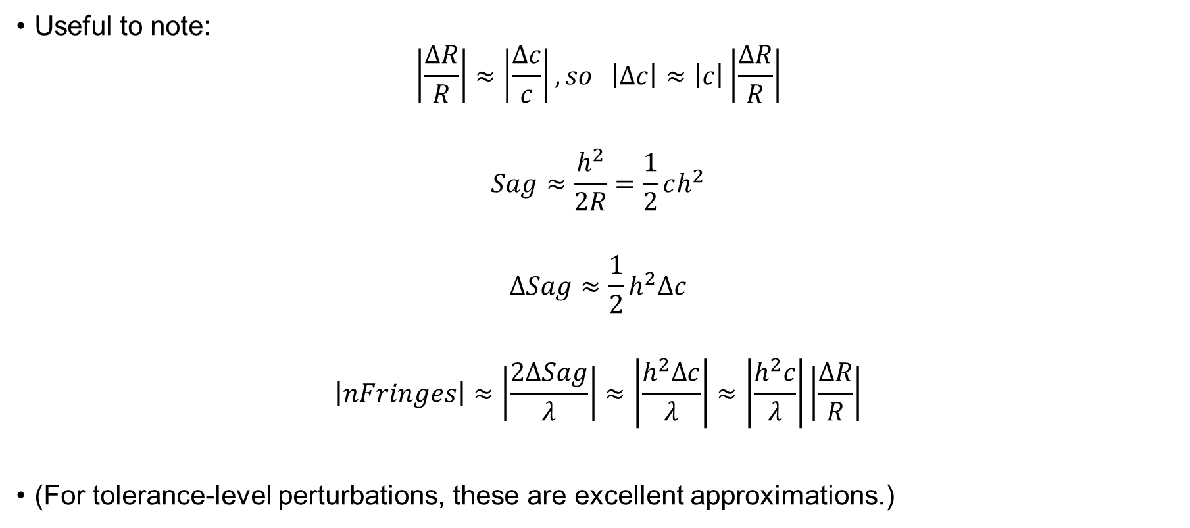
Delta-R versus Fringe Count
Useful to note:
$$\left|\frac{∆R}{R}\right|≈\left|\frac{∆c}{c}\right|, so \left|Δc\right|≈\left|c\right|\left|\frac{∆R}{R}\right|$$
$$Sag≈\frac{h^{2}}{2R}=\frac{1}{2}ch^{2}$$
$$ΔSag≈\frac{1}{2}h^{2}Δc$$
$$\left|nFringes\right|≈\left|\frac{2ΔSag}{λ}\right|≈\left|\frac{h^{2}Δc}{λ}\right|≈\left|\frac{h^{2}c}{λ}\right|\left|\frac{∆R}{R}\right|$$
(For tolerance-level perturbations, these are excellent approximations.)

Slide 23
Macro Code for Generating Radius Tolerances
!Do Radius tolerances
for ^s 1 (num s)-1
if (dum s^s)= 0
!Is not a dummy surface
^fractionalDr == 0.001 !0.003, 0.001, 0.0005
^FringeVal == 1 !3, 1, 0.5
!Calculate Fringe tolerance equivalent to the dR tolerance
^h==(mav s^s)!MAV is the max aperture radius for this surface over all zooms
^equivFringes == ^h**2*(cuy s^s)*^fractionalDr/^lambdaMM
^fringeTolValue==maxf(^equivFringes,^FringeVal) !find the worse of the two
DLF S^S ^fringeTolValue
end if
end for !^s

Slide 24
See SetTols.Seq
A full listing of the “first-guess” tolerances for the lens
More useful information on tolerances in the appendix to this presentation

Slide 25
“As-Built Performance” (A Probability Distribution)

Slide 26
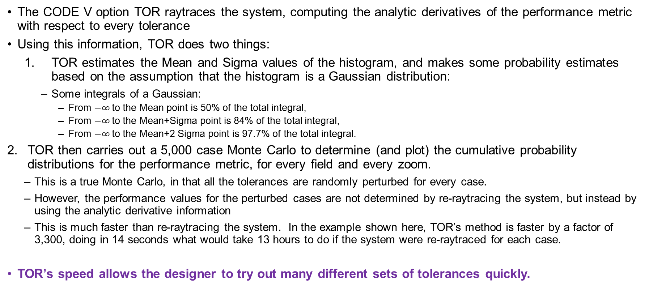
TOR
The CODE V option TOR raytraces the system, computing the analytic derivatives of the performance metric with respect to every tolerance
Using this information, TOR does two things:
TOR estimates the Mean and Sigma values of the histogram, and makes some probability estimates based on the assumption that the histogram is a Gaussian distribution:
Some integrals of a Gaussian:
From $−∞$to the Mean point is 50% of the total integral,
From $−∞$to the Mean+Sigma point is 84% of the total integral,
From $−∞$to the Mean+2 Sigma point is 97.7% of the total integral.
TOR then carries out a 5,000 case Monte Carlo to determine (and plot) the cumulative probability distributions for the performance metric, for every field and every zoom.
This is a true Monte Carlo, in that all the tolerances are randomly perturbed for every case.
However, the performance values for the perturbed cases are not determined by re-raytracing the system, but instead by using the analytic derivative information
This is much faster than re-raytracing the system. In the example shown here, TOR’s method is faster by a factor of 3,300, doing in 14 seconds what would take 13 hours to do if the system were re-raytraced for each case.
TOR’s speed allows the designer to try out many different sets of tolerances quickly.

Slide 27
Histogram of Occurrences (Probability Density)
Number of Occurrences
Histogram,
For a single field point
For a single orientation
1
MTF value
0
⇦ Better Worse ⇨

Slide 28
Probability of Success
Number of Occurrences
These are the cases that have an MTF of 0.3 or better.
The probability of the being 0.3 or better is given by this area
Arbitrary Acceptance Criterion
(Say, 0.3)
1
⇦ Better Worse ⇨
0
MTF
0.3

Slide 29
Cumulative Probability Distribution
Cumulative Probability
1.0
Probability of the MTF being X or better
The integral, from MTF= 1 to MTF= X, of the histogram.
Gives the probability of the MTF being X or better
0.0
1
MTF
0
X

Slide 30
Cumulative Probability Distribution = Yield Curve
Cumulative Probability
1.0
0.9
0.5
Worst Case Performance
0.0
1
Performance this good or better in 50% of cases
Performance this good or better in 90% of cases
0

Slide 31
Asymmetry of the Cumulative Probability Distribution
Cumulative Probability
1.0
0.9
This curve is typically NOT symmetric, but typically has a longer “tail” on the right than on the left.
(There are more ways for a system to be bad than for it to be good.)
For this reason, the curve is generally more accurate than the 50%, 84%, and 97.7% numbers based on Gaussian statistics.
0.5
0.0
1
0

Slide 32
See runTor.Seq
The commands I used to run TOR for this lens

Slide 33
TOR Results
Cumulative Probability Distributions

Slide 34
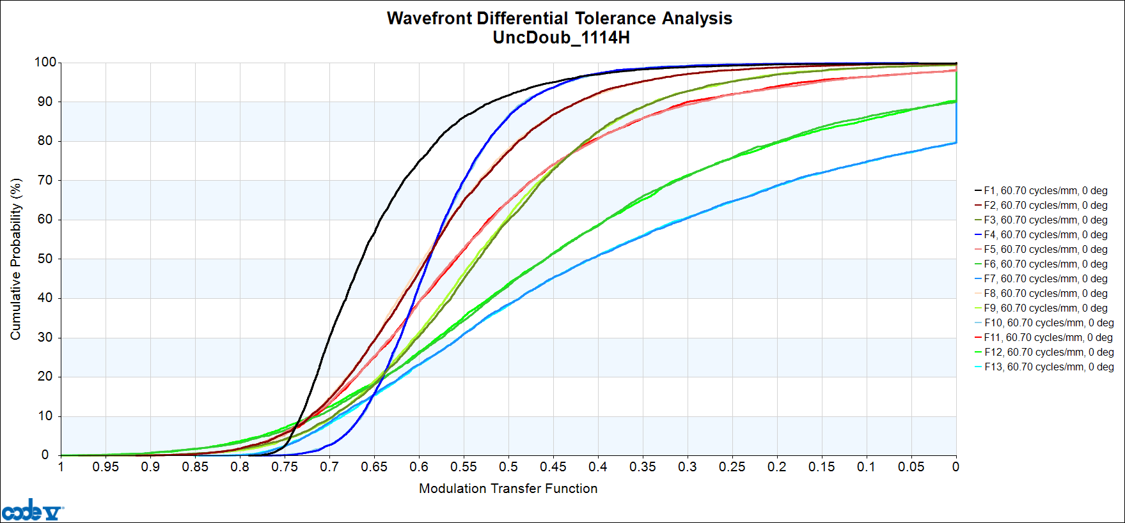
TOR, Initial Tolerance set (SetTols) (5000 cases, 0º MTF, Runtime = 14 seconds)

Slide 35
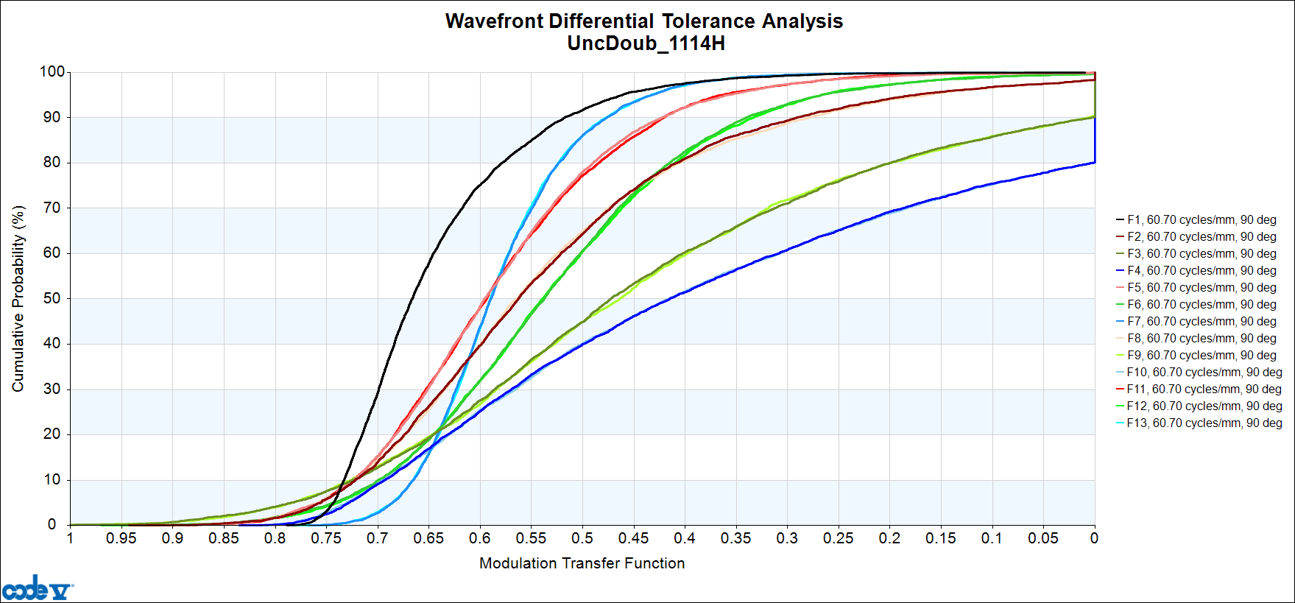
TOR, Initial Tolerance set (SetTols) (5000 cases, 90º MTF, Runtime = 14 seconds)

Slide 36
Comments
The results for the 0º and 90º MTF orientations are the same, except the field locations have exchanged places on the graph.
This makes sense, given how the fields are set up.
We will only show the 0º MTF plots from here on.
With the initial set of tolerances, the performance is not very good. For the spatial frequency in question, some of the fields (corresponding to a “corner” position) have curves that reach all the way to the right-hand edge of the plot.
For instance, there is a pair of blue curves (F7 and F13, for the 0º MTF; F4 and F10, for the 90º MTF) that reach the right-hand edge at a probability level of 80%
This means those field points will attain an MTF of “zero or better”, with a probability of 80%
More succinctly, this means there is a 20% probability that these field points will show zero MTF at this frequency.
We need to tighten something.

Slide 37
The Sorted Sensitivities Deciding what to tighten: the “Worst Offenders”
TOR provides (if you ask for it) a list of the sensitivities (derivatives) of the performance metric (in this case MTF) with respect to every tolerance, at every field point and every zoom position.
These data appear in a buffer that can be exported to a tab-delimited file that can be opened with EXCEL. (See Sensitivities.xlsx)
In this example, there are 226 tolerances
There are 13 field positions
We also have 2 zoom positions: one in which we tolerance the Y-MTF and the other in which we tolerance the X-MTF
Therefore, the sensitivity table contains 226*13*2 = 5876 lines of data… a lot to look through!
We can sort the data to find the tolerances that affect the MTF most strongly… these are the ones we would like to tighten.

Slide 38
The Sorted Sensitivities Two short cuts
Examining the sensitivity table is easiest in EXCEL because of the tab-delimited format.
To save time, we can have CODE V sort the data before exporting to EXCEL, so we don’t have to do that step in EXCEL.
This code is at the end of the RunTor.seq macro
We can also have CODE V list the first few (say, 20) lines of the buffer to the CODE V output window.
This won’t look as nice as in Excel, because the tabs are treated as spaces; however, it is sufficient to see what the most important tolerances are, without having to go to EXCEL at all.
The RunTor.seq macro also includes the statement to list the first 20 lines of sensitivity data.

Slide 39
Tighten a Few Tolerances
From the sensitivity information, we can see that the following tolerances appear at the top of the sorted list:
DLV (delta-Abbe) of surfaces E3, E6, and E11,
DSX, DSY (decentrations) of the E7-E8 cemented doublet,
BTX, BTY (barrel tilt) of the E7-E8 doublet.
Therefore, we decide to tighten:
The DLV tolerances of ALL surfaces from “Step 3” to “Step 2,”
The BTX, BTY tolerances of the E7-E8 doublet to 0.010 mm over the full diameter,
The decenter tolerances of the E7-E8 doublet to the tight end of the range.
We make these changes in the SetTols macro, which we rename to SetTolsAAA.seq.
As the following plot shows, the performance of the system with the tighter tolerances is much improved, though still not where we would like it to be…

Slide 40
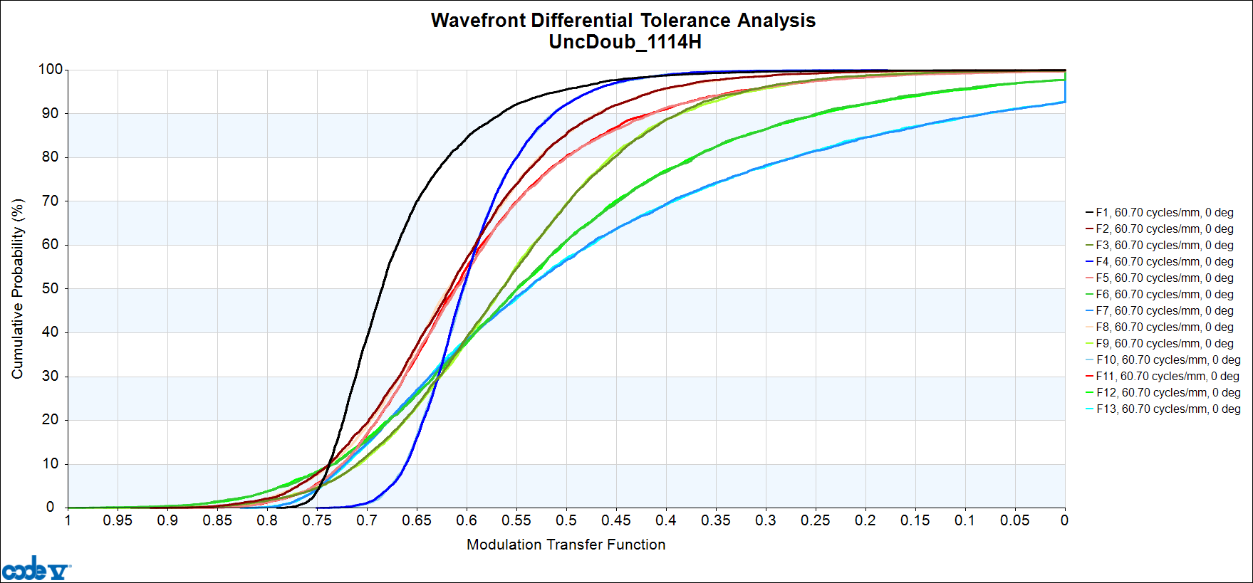
TOR, with some tolerances tightened (See SetTolsAAA.seq)

Slide 41
New List of “Worst Offender” tolerances
The new sorted list of sensitivities shows the following three tolerances to have the most effect:
Barrel tilt of the E9..E10 doublet
Tilt of the E8S2 surface (= wedge of E8)
Decenter of the E11-E12 doublet
Accordingly, we tighten these (see SetTolsBBB.seq) and rerun TOR, producing the slide on the next slide...

Slide 42
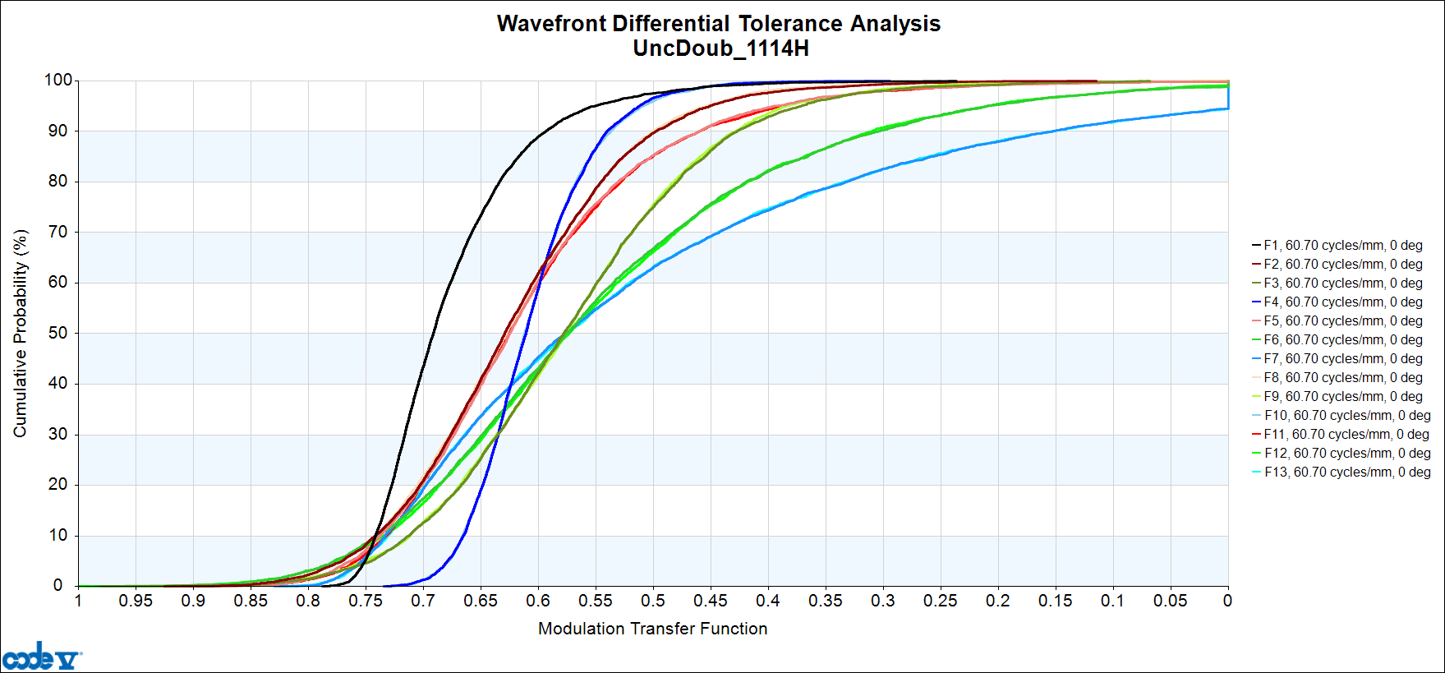
TOR, with more tolerances tightened (See SetTolsBBB.seq)

Slide 43
Comments
Again, the performance is better, though still not what we would like.
At this point, the worst offenders are:
Barrel Tilt of the E7-E8 doublet (already tightened; hard to make tighter)
Barrel Tilt of E3
Decenter of E3
Wedge of E10
DLV of E3 (already tightened, though we could go tighter if we have to)
We could continue tightening, but at this point we choose instead to explore using post-assembly adjustments to the system (“compensators”)
We are already using refocus (motion of the image plane) as a compensator.
We now add tilt of the image plane as a compensator.
CODE V Syntax point: Because we have asymmetric tolerances of three kinds (unlabled, L’as2’, and L’as3’) we need to enter compensators for all 3 of those labeled groups
We also add the longitudinal spacing (DSZ) of E11 as a compensator
Because we have symmetric tolerances of two kinds (unlabled and L’sym’) we need to enter compensators for both of those labeled groups
See SetTolsCCC.seq.

Slide 44
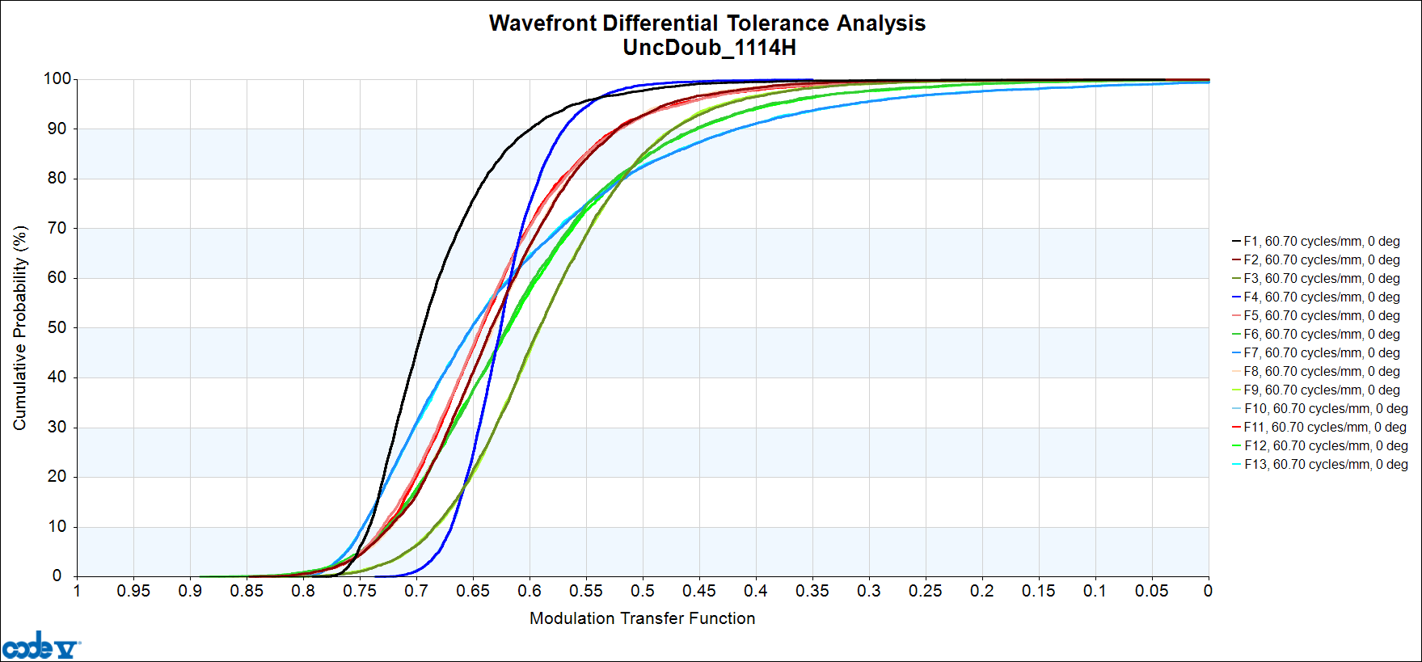
TOR, with more tolerances tightened (See SetTolsCCC.seq)

Slide 45
Comments
The performance is now much better
At this point, the worst offenders include some surface irregularities (which we can tighten) as well as some element tilts that we cannot tighten.
Accordingly, we make the following adjustments:
Tighten IRR from1 Fringe to 0.5 Fringes on E7S1, E8S2, E9S1, E10S2.
Tighten Index tolerances to 0.0003 (Step 2, now matches the Abbe tolerance)
Add, as a compensator, the decentration of the entire rear group (from the stop to the image). This would be controlled by decentering the rear half of the housing relative to the front half of the housing.

Slide 46
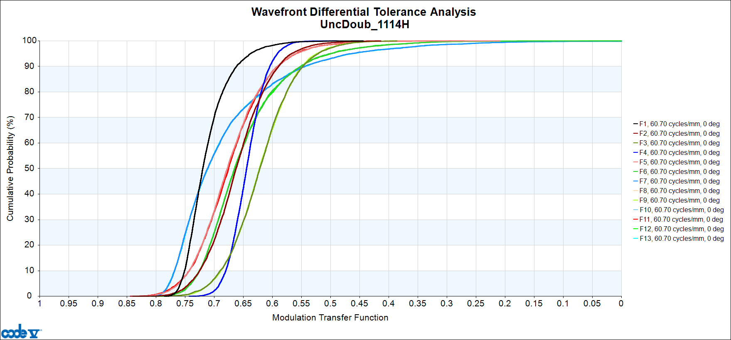
TOR Results See SetTolsDDD.Seq

Slide 47
Tolerances on the Compensators
At this point, the performance looks good: There is a high probability of reaching a very good MTF value at all fields!
But here is an important question: How accurately do the compensations need to be made? (Or conversely: If there are slight inaccuracies – tolerances – on the motions of the compensators themselves, how severely is the performance affected?)
To answer this last question, we implement a few new tolerances, that are identical to the compensators themselves, but with a new label (‘unc’) that is not used by any compensator group.
This means that these tolerances on the compensators will not be compensated by anything.
In a sense, they represent “the last thing to happen to the system.”
These new tolerances are:
dlt si-1 L'unc' 0.00625 !This is the depth of focus at F/2.5. Can't be much looser than that!
dla si L'unc' 0.005/36 !Controlled by shims
dlb si L'unc' 0.005/36 !Controlled by shims
dsz s'e11s1'..'e12s2' L'unc' 0.00625 Controlled by shims
dsx ss..i-1 L'unc' 0.010 !This is relatively tight
dsy ss..i-1 L'unc' 0.010 !This is relatively tight

Slide 48
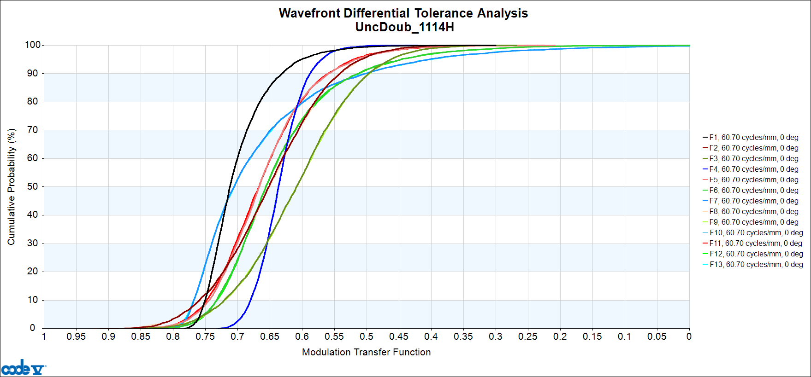
TOR Results, with Tolerances on the Compensators See SetTolsEEE.Seq

Slide 49
Comments
Adding the tolerances on the compensators definitely degraded the performance, but the performance is still better than if we did not have the compensators, so they are still worth implementing.
One last thing to worry about: How accurate is TOR?
TOR is very fast, but we said it was based on some assumptions about the changes being small enough that a perturbation analysis was accurate.
Is it accurate enough?
To answer that, we run a full Monte Carlo that re-raytraces the system for every case
This will be slow!
Running 5,000 cases would take over 13 hours.
We will run 500 cases; that will take about 1.3 hours.
Use the CODE V macro TOLMONTE

Slide 50
How Accurate is TOR?
TOR is very fast, but we said it was based on some assumptions about the changes being small enough that a perturbation analysis was accurate.
Is it accurate enough?
To answer that, we run a full Monte Carlo that re-raytraces the system for every case
This will be slow!
Running 5,000 cases would take over 13 hours.
We will run 500 cases; that will take about 1.3 hours.
Use the CODE V –supplied macro TOLMONTE. See the macro RunTolMonte.seq that calls TOLMONTE.

Slide 51
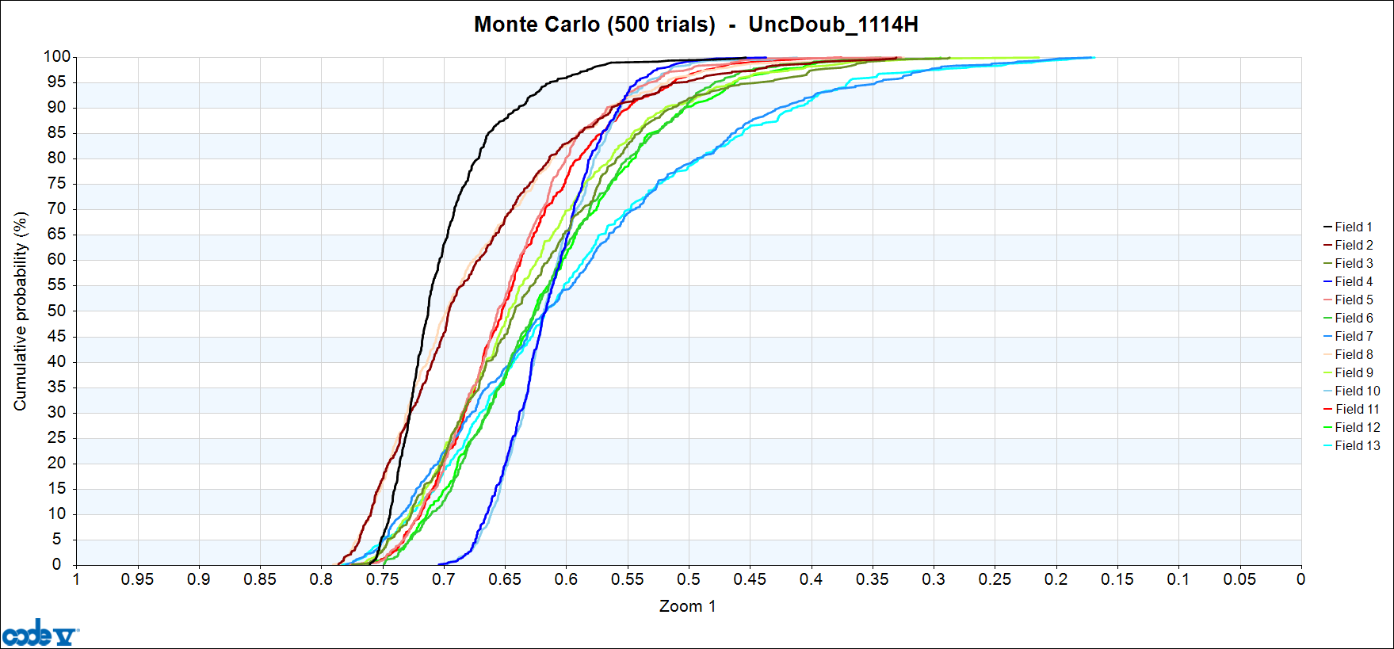
True Monte Carlo, 500 cases (Runtime = 1 hour, 17 minutes)

Slide 52
Comments
Comparing the TOLMONTE results with the TOR results, we see that the results are very similar, though not exactly the same.
There is still a high probability that a very good MTF value will be achieved at all field points
Basically, this says that TOR and TOLMONTE are “telling us the same story” though some of the details are different.
The curves for the “corner” field points (for one of the two orientations) are slightly worse in the TOLMONTE results
In most applications, these results would still be acceptable at the corner of the field.
If not, one could examine the sensitivities to see what tolerances were affecting the corner fields the strongest, and tighten those tolerances specifically.
Wherever TOLMONTE and TOR disagree, one has to believe the TOLMONTE results, however:
TOR is still very accurate, and
Because of the extreme speed of TOR, we were able to “iterate” the tolerances to get good results in a short amount of time

Slide 54
APPENDIX: Supplemental Information on Manufacturing Techniques and Tolerances

Slide 55
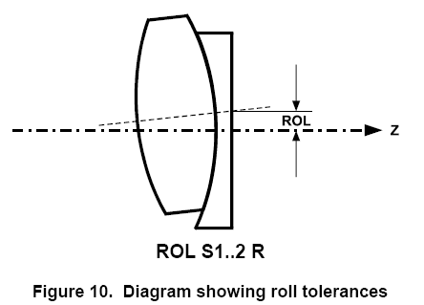
V-Block Alignment
The two components are edged to the same diameter, and then squeezed between V blocks for cementing.
If they are not exactly the same diameter, an error results
Use a ROL tolerance to represent this error
From: Arbeitsverfahren der Feinoptik, H. Shade, Deutscher Ingenieur-Verlag GmbH (1955)

Slide 56
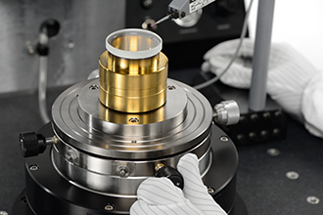
Spindle or Air-Bearing Alignment
If the fabricator is using a probe to measure the runout of the optical surfaces, then:
It is possible (and indeed, likely) that the tilt of the top surface of the doublet will at least partially compensate for any runout of the middle (cemented) surface
Use TIR tolerances on the middle and top surfaces to represent the tilts of those surfaces relative to the bottom surface.
From: http://optoalignment.com/services/lens-assembly/

Slide 57
Why Does it Matter?
ROL plus wedge of the bottom element is equivalent to a wedge of the two elements
…which is equivalent to TIR of the middle and top surfaces
…which is equivalent to DLA, DLB of the middle and top surfaces
It is a matter of communication with the fabricator.
If the fabricator measures TIR:
They can estimate the accuracy of the TIR measurement
They cannot easily estimate the accuracy of the equivalent ROL tolerance
The equivalent ROL tolerance varies with the curvature of the cemented surface, so it is not a simple number that they can quote
If you ask them what ROL tolerance they can easily hold, they may give an answer that isn’t very useful

Slide 58
How will the Lenses be Mounted?
Dropped into a tube, with spacers?
Cemented onto lens seats turned into the housing?
Ball-Chuck Centering (a.k.a. “Alignment Turning”)?
Lenses are cemented into metal cells
Cells are chucked into a special lathe with an integrated alignment telescope
The chuck is adjusted so that the optical surfaces are true to the rotation axis of the lathe
The outer edges of the metal cells are turned to the desired diameter

Slide 59
Irregularity
“Irregularity” refers to long-period errors on the surface that are not spherical.
In traditional, pitch-polishing of spherical surfaces, surface errors are mostly astigmatic in nature.
For centuries, it was common to assume that “irregularity” and “astigmatic surface error” were the same.
Modern polishing techniques can produce errors that are not astigmatic in nature.
For instance, high-speed polishers frequently produce surface errors that are rotationally symmetric
In CODE V, Irregularity is modeled as an astigmatic surface error
It is possible to model other error types as well, but “Irregularity” means astigmatic.
At the lowest level of approximation:
It does not much matter what the shape of the non-spherical surface perturbation is…
The important thing is that it be a long-period error that is not refocusable.

Slide 60
Irregularity (Rules of thumb)
The “classical” rule, for test plates:
The irregularity specification should be no tighter than 1/3 to 1/4th of the spec for spherical fringes from a test plate.
Reasoning: You can’t measure irregularity to 1/20th of a fringe in the presence of a large “power” error.
This rule is good to know and even adhere to, but becoming outdated:
Digital interferometry has improved our measurement capability
Many shops no longer measure using test plates
Rules of thumb (for parts in the 25 – 50 mm diameter range):
Easy: 3 Fringes
Medium: 1 Fringe
Hard: 1/2 Fringe
(If you are violating the rule of 1/3 - 1/4 of “power” rule, be aware of what you are doing.)

Slide 61
Glass Thickness Errors
Fabricators like to stop polishing when the surfaces are good
For this reason they like loose tolerances on thickness
Elements typically end up too thick more often than too thin.
Rules of thumb (for pitch-polished surfaces)
Easy: 0.100 mm
Middle: 0.050
Hard: 0.025
In reality, what is easy or hard depends on the fabrication technology.
0.025 mm is “hard” for pitch polishing, but not hard if a high-speed polisher is being used.
Use the telephone!

Slide 62
Airspace Errors
For mechanically machined parts (spacers, etc.) talk to the housing manufacturer – the folks who will cut the metal.
Typical values for the accuracy of machined parts:
Easy: 0.050 mm
Medium: 0.025 mm
Hard: 0.012 mm
Airspace Tolerances depend on how the parts are to be mounted…

Slide 63
“Loose Elements And Spacers”
An error in the length of one spacer influences the locations of all the lens elements.
Thickness errors of the elements themselves also influence the locations of the other elements.
To model this kind of a “stack-up” use DLT tolerances in CODE V, for both lens thicknesses and air spaces.
Example:
DLT S1 0.050 !Glass
DLT S2 0.025 !Air
DLT S3 0.050 !Glass
DLT S4 0.025 !Air
(etc.)

Slide 64
Lens Elements Mounted Against Housing Seats
An error in the location of one housing seat influences only the location of that one lens element.
The locations of other elements are independent of errors of the other seats.
… and also independent of the thickness errors of the elements themselves
To model this in CODE V, couple each lens (DLT) thickness tolerance to the tolerance on the neighboring air space with a -1 scale factor, so the air tolerance automatically adjusts for the thinner or thicker lens. Then use an additional DSZ tolerance on each of the lens positions…

Slide 65
Lens Elements Mounted Against Housing Seats
Example:
!Enter thickness tolerances, with couplings to the neighboring air spaces:
DLT S2 C -0.050 !Air
DLT S3 0.050 !Glass
DLT S4 C -0.050 !Air
DLT S5 0.050 !Glass
!Enter lens position tolerances:
DSZ S3..4 0.025 !Air
DSZ S5..6 0.025 !Glass
3
4
5
6
Surface Numbers

Slide 66
Index and Dispersion Errors
For glass elements, the range from “easy” to “hard” may be judged by examining Schott’s index accuracy categories*
Description | Index Accuracy (Relative to the Catalog) | Fractional Abbe Accuracy (Relative to the Catalog)
Uncategorized | ±0.0010 | ±0.008 (0.8%)
Step 3 | ±0.0005 | ±0.005 (0.5%)
Step 2 | ±0.0003 | ±0.003 (0.3%)
Step 1 | ±0.0002 | ±0.002 (0.2%)
Step 0.5 (Only available for certain glasses) | ±0.0001 | ±0.001 (0.1%)
*Reference: Schott TIE #29: Refractive Index and Dispersion

Slide 67
Alignment Errors: Wedge, Decenter and Element Tilt
For spherical elements, wedge, decenter and tilt are mathematically “equivalent.”
Decentering an element is “equivalent” to adding wedge and tilting the element.
It is possible (though not recommended) to model decenter and wedge by tolerancing the tilts of the individual surfaces.
The couplings among the surface tilts are complex and depend on the radii, etc.
However, Wedge, Decenter and Element Tilt are independent degrees of freedom that “go wrong” for different reasons.
For this reason, it is best to:
Recognize that Wedge, Decenter and Element Tilt as being independent variables,
Enter separate tolerances for them.

Slide 68
Wedge
In fabrication, wedge is controlled via some variant of the following:
Wax the bottom surface of the (initially oversized) part against an accurate spindle
This surface now “runs true”
Measure (either optically or with a dial indicator) the “wobble” of the top surface
“wobble” = Total Indicated Runout (TIR) a.k.a. Edge Thickness Difference (ETD)

Slide 69
Wedge (continued)
Slide, or “roll” the element against the spindle until the top surface also “runs true”
Of course, it never runs perfectly true… There is always some error in the TIR
This winds up being our tolerance
Roll

Slide 70
Wedge (continued)
With the element rotating on this spindle, bring in a grinding wheel to trim the outer diameter (OD) of the element to the correct diameter.
The error in this procedure is given by the accuracy to which the TIR can be set
Easy: 0.025 mm TIR
Medium: 0.010 mm TIR
Hard: 0.005 mm TIR

Slide 71
Wedge Tolerance Syntax in CODE V
To model wedge in CODE V, use a TIR tolerance on one surface (but not the other).
Typically, these would be applied to all the “outside” surfaces but not the ones that contact seats.
Example:
TIR S3 0.010
TIR S5 0.010
(etc.)
3
4
5
6
Surface Numbers

Slide 72
Wedge of Precision Doublets
Precision Doublets are typically made as follows:
Center one element (the “carrier”) on a spindle.
The bottom surface runs true automatically.
Adjust the position so the top surface runs true.
Dispense the cement onto the upper surface of the carrier element.
Place the upper element onto the carrier .
Adjust the transverse position of the upper element so its upper surface runs true.
The bottom surface runs true because it is against the carrier element.
Use a UV light source to set the cement.
NOTE: the wedge error of the bottom element does not add to the wedge of the upper element!

Slide 73
Wedge Tolerances for Precision Doublets
There are 3 surfaces:
One air-glass surface gets no tolerance; this is the “reference” surface.
The middle surface gets a TIR tolerance to represent the wedge of the “reference” element.
The other air-glass surface gets a TIR tolerance to represent the wedge of the doublet (pair).
Example (Assuming the doublet is surfaces 3, 4, and 5, with S5 pressed against a seat):
TIR S4 0.010
TIR S3 0.010
(No tolerance on S5)
Things to note:
The tolerances on element wedge and doublet wedge are independent of each other
The tolerance on doublet wedge does not have to be looser than the element wedge tolerance… it can even be tighter than the element wedge tolerance!
It usually works out that the tolerance on doublet wedge is more important than the tolerance on element wedge. (The cemented surface has a lower delta-n, so it is less sensitive)

Slide 74
Element Decenter and Tilt Tolerances
There are many ways that optical elements can be mounted:
Loose elements and spacers in a tube
Elements bonded to a housing having individual seating surfaces
Decenters can be controlled by the ODs of the elements
Decenters can be adjusted on an air bearing table
Alignment turning: Elements bonded into cells; elements are optically aligned to the turning axis of a lathe, then the OD and thicknesses of the cells are turned to the desired dimension… and then the cells are inserted into a housing
Et cetera.
For this exercise we will assume the elements are mounted against seats turned in a housing.

Slide 75
Element Tilt Tolerances
If an element is pressed against a lens seat, the element tilt is controlled by the following:
The accuracy of the seat (any burrs left by the turning?)
The accuracy with which the lens can be pressed against the seat (any dust in between?)
The diameter of the part
Typical values:
Easy: 0.025 mm (±0.0125) over the part diameter
Middle: 0.015 mm (±0.0075) over the part diameter
Hard: 0.010 mm (±0.005) over the part diameter
CODE V syntax:
The BTI (“barrel tilt”) tolerance simulates a tilt to an entire element (a group of consecutive surfaces), without tilting the axis for the remainder of the system.
The syntax is BTI Sj..k <tilt_value_in_radians>
The value in radians can be an expression involving the semi-diameter (SD) value and the assumed perturbation in mm
Example: BTI S10..11 0.025/(2*(SD S11))

Slide 76
Element Tilt Tolerance for Concave Surfaces
It the part is concave, and the housing seat will contact the edge flat rather than the optical surface, then it is necessary to consider an additional tolerance for the angular error of the edge flat.
Plane of edge flat not orthogonal to the axis defined by the centers of curvature
C₂
C₁
Easy: 0.015 over the diameter of the concave surface
Medium: 0.010 over the diameter
Hard: 0.005 over the diameter

Slide 77
Element Decenter Tolerances
For elements constrained by their edge cylinders in a tube, three independent tolerances contribute to the total decenter of the element
The mechanical engineer designs the housing to be slightly larger (Typically 0.100, 0.050, or 0.025) than the OD of the optical element
Since the “overage” is on the diameter, this allows the element to decenter by half the overage value, e.g., 0.050, 0.025, or 0.0125.
The housing has an asymmetric inner diameter tolerance such as (+0.025, -0)
This is equivalent to saying that the nominal clearance is increased by 0.0125, with a symmetrical ID tolerance of ±0.0125
The optical element has an asymmetric OD tolerance such as (+0, -0.025)
This is equivalent to saying that the nominal clearance is increased by another 0.0125, with a symmetrical OD tolerance of ±0.0125

Slide 78
Element Decenter Tolerances (CODE V syntax)
When entering multiple tolerances of the same type on the same surface in CODE V, it is necessary to use “labels” to prevent the second tolerance from overwriting the first.
For Example:
DIS S10..11 L’nom’ 0.050
DIS S10..11 L’dID’ 0.025
DIS S10..11 L’dOD’ 0.015

Slide 79
What are the Probability Distributions for the Errors?
The Fabricator may not know the answer to this!
A related question, that they probably DO know the answer to, is whether they are “Cherry Picking” the parts
If the fabricator is making lots of parts and picking out the (few) good ones, then the probability distribution is essentially flat, all the way out to the tolerance (=cutoff value)
If the fabricator says, “No, we just make the parts and almost all of them meet this tolerance” then the probability distribution falls off significantly from the middle, and is very low at the tolerance value.
For Scalar (1-D) tolerances, like DLF, DLT, and DLN, see the PDS command from TOR
For 2-D tolerances, like DIS, BTI and TIR (but not IRR), see the PDD command from TOR (Choices are UNI, GAU, END, with a default of GAU, truncated at 0.135)
For Irregularity, see the PDI command from TOR (Choices are UNI, GAU, END, with a default of UNI)
If you are using TOLFDIF/ TOLMONTE, see the U2D, G2D commands

Slide 80
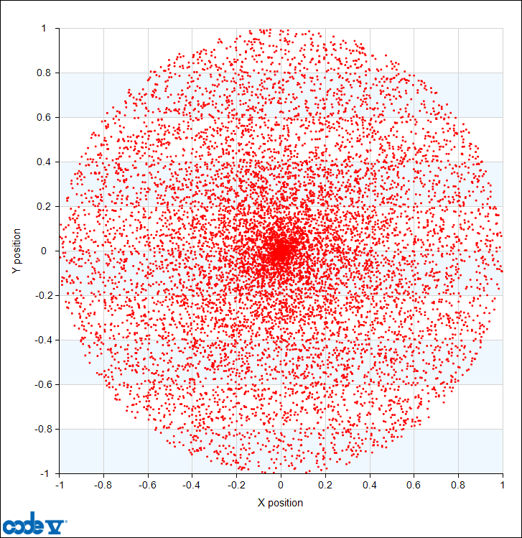
2-D Probability Distributions
As a thought-experiment:
Imagine a distribution (in R) that is UNIFORM on [0,1] (e.g., Cherry Picking)
Imagine that the distribution is UNIFORM in azimuth
That distribution looks like this:
The probability density decreases linearly with R (that is, it is a cone):
Imagine dividing it into an number of radial zones
Each zone has the same number of dots
In the outer zones these dots are distributed over a larger area
(This is not a distribution that CODE V supports, but it is a useful introduction to the ones we do support…)

Slide 81
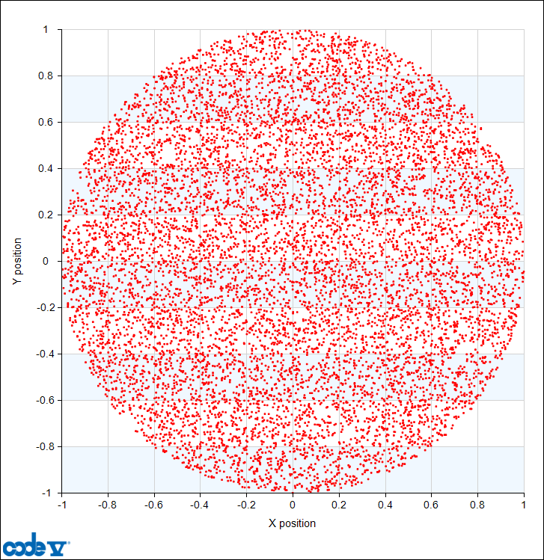
The UNI distribution (Also known as U2D if you are using User Defined Tolerances)
To get a distribution whose density is UNIFORM on a 2D circle,
The probability distribution has to increase linearly from 0 at R=0 to a maximum at R=Rmax.
(Assuming that the azimuthal distribution is uniform, as in the last example)
This is the UNI distribution, shown at right
TOR applies this, by default, to IRR but not DIS

Slide 82
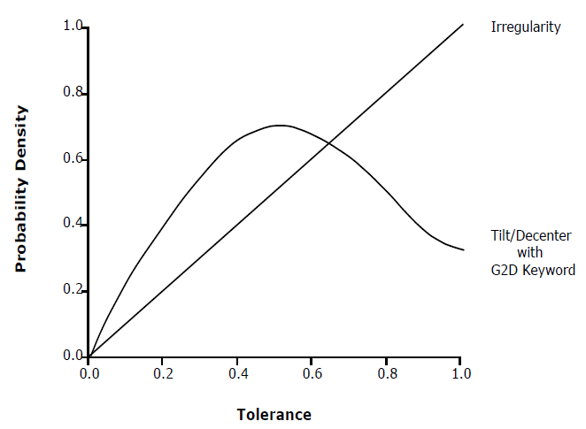
The GAU 0.135 distribution (Also known as G2D if you are using User Defined Tolerances)
To obtain a distribution whose 2D probability density is Gaussian, the distribution in the radial direction (before the application of the random azimuth) needs to be a Rayleigh distribution, which rises from 0 at R=0, then peaks at an intermediate value of R, and decreases after that
TOR uses this, by default, for Decenters and Tilts.

